Slide 1
Recitation 10
Greg, Will, Sheil

Slide 2
Agenda
Understanding the Competition
Finite State Machines and Revisiting PD Control Systems
Autonomous Wall Following
Wall Following Demo with Limit Switches
Adapting Design to use Ultrasonic Sensors
Vive Circuit
Note: Autonomous Wall Following is one of the requirements for the final project.

Slide 3
Questions on the competition?
Beacons & Cans:
Rules/scoring:

Slide 4
Wall Following
How do we move in a straight line along a wall?
What sensors might be useful?
What should happen if the robot can no longer move forward?

Slide 5
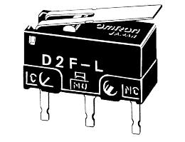
Wall Following with Limit Switches
Limit switches can be used to get a binary signal about if contact has occurred

Slide 6
Finite State Machine for Wall Following in a Loop (with Limit Switches)
Moving Along Edges
Right limit switch breaks contact
START
Move forward with a rightward bias
Move forward away from the wall
(leftward bias)
Right limit switch makes contact
Left turn timer counts down to zero
Front limit switch makes contact
Turn 90 degrees left
(determined by countdown timer)
Front limit switch breaks contact
+
Backoff timer counts down to zero
Back off from wall a small distance (determined by countdown timer)
Turning Left

Slide 7
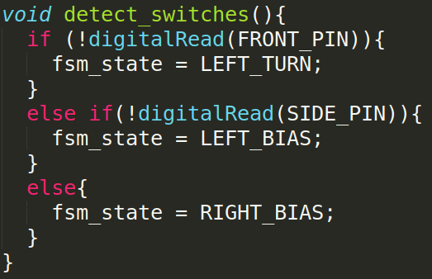

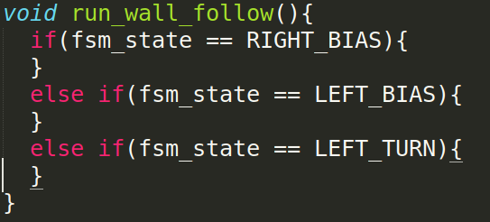
Wall Following Implementation with Limit Switches
Why might we want to separate these two functions?
Other ways to structure the code?

Slide 8
Wall Following with an Ultrasonic Sensor instead of a Limit Switch
Ultrasonic sensor outputs distance instead of a binary in-contact/not in-contact
What can we do with the additional resolution?

Slide 9
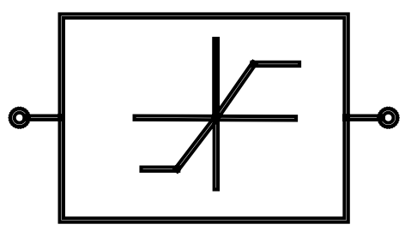
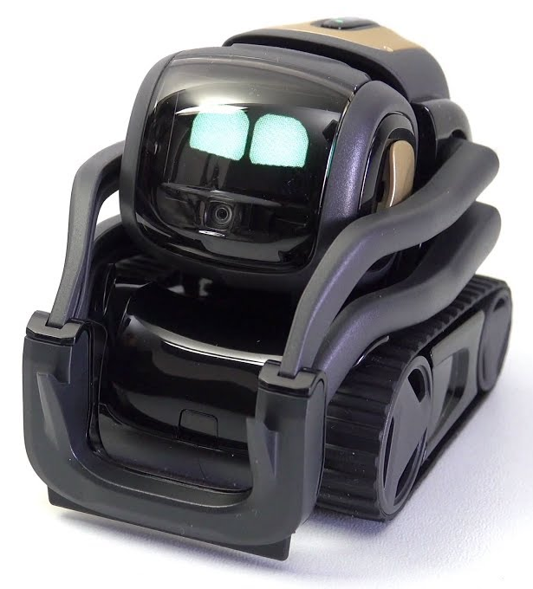
Wall Following with an Ultrasonic Sensor instead of a Limit Switch
d_{des}
d _{error}
K_{p}
Proportional Gain Controller
Rate Limiter
bias
Σ Create Steering Angle Command
Motor PWM
Robot State
+
-
d _{feedback}
d_{des} = Desired Wall Following Distance
bias = Tilt in steering angle (left or right)

Slide 10
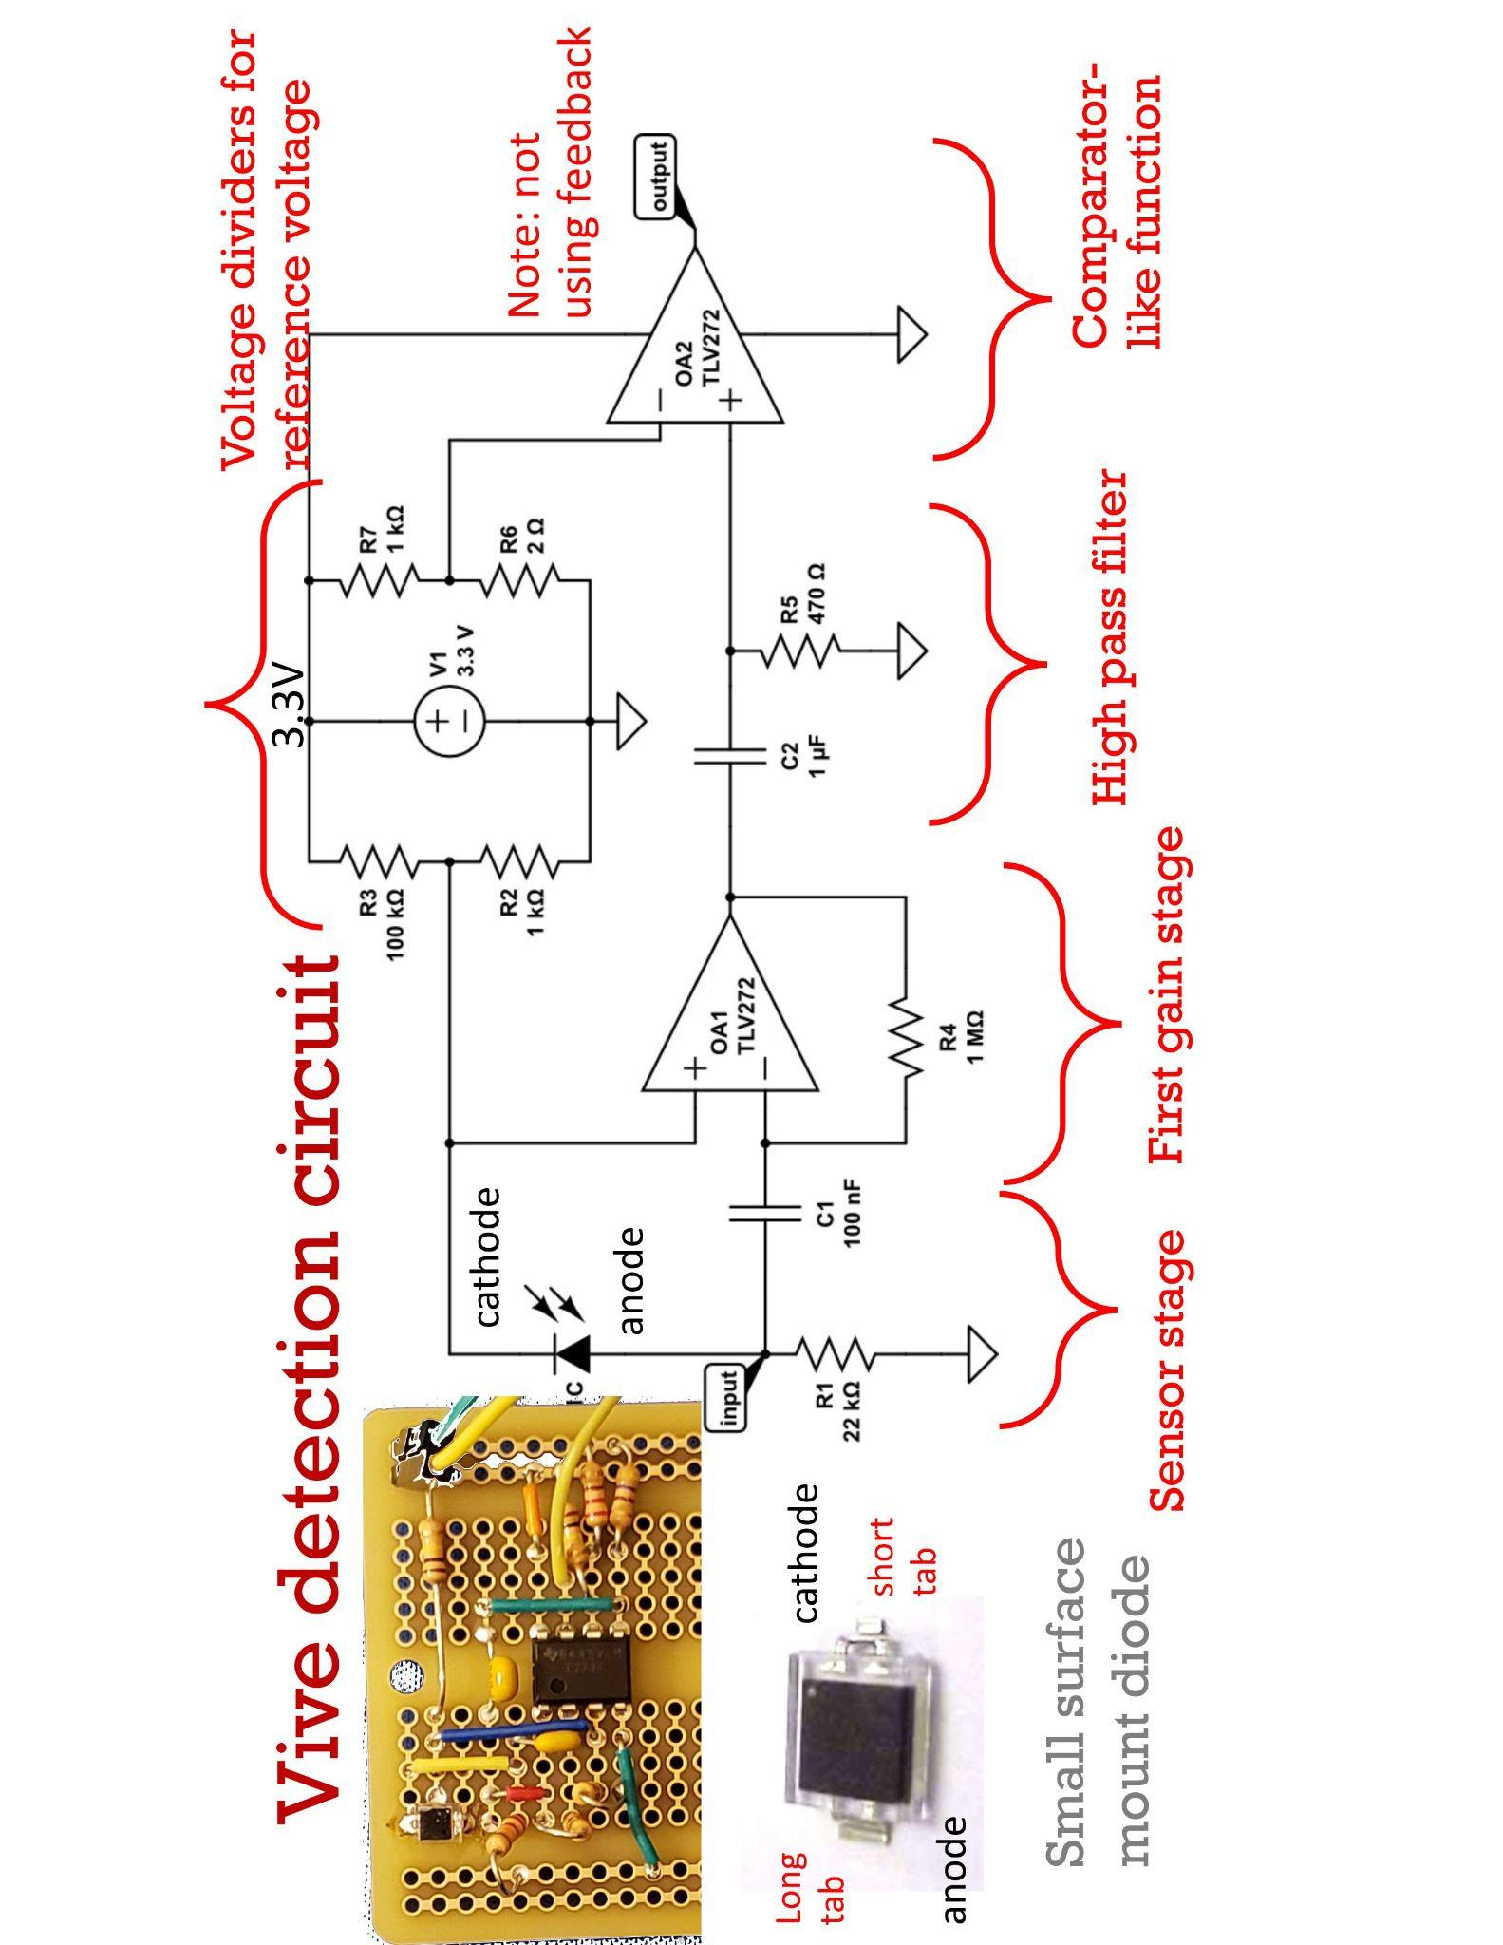
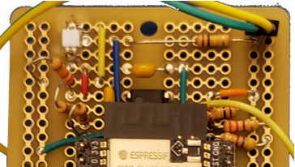
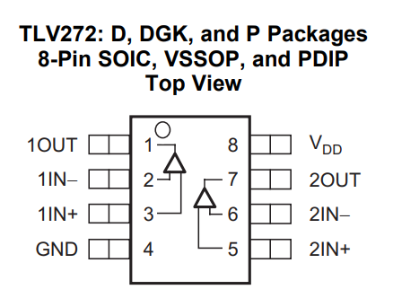
Vive Circuitry
(100k)
(220)

Slide 11
Vive Circuit Components
1x Perfboard
1x PD70-01C Diode
1x TLV272 Op-Amp
1x ESP32 (w/ Female headers for mounting)
1x 1 uF C
1x 100 nF C
1x 1 kOhm R
1x 22 kOhm R
1x 1 MOhm R
1x 470 Ohm R
2x 100 kOhm R
1x 220 Ohm R
100 kOhm
220 Ohm

Slide 12
Vive Circuit Components
1x Perfboard
1x PD70-01C Diode
1x TLV272 Op-Amp
1x ESP32 (w/ Female headers for mounting)
1x 1 uF C
1x 100 nF C (2x 47 nF for now...)
2x 1 kOhm R
1x 22 kOhm R
1x 1 MOhm R
1x 470 Ohm R
1x 100 kOhm R
1x 2 Ohm R (Not available)
R7 / R6 = ~500

Slide 13
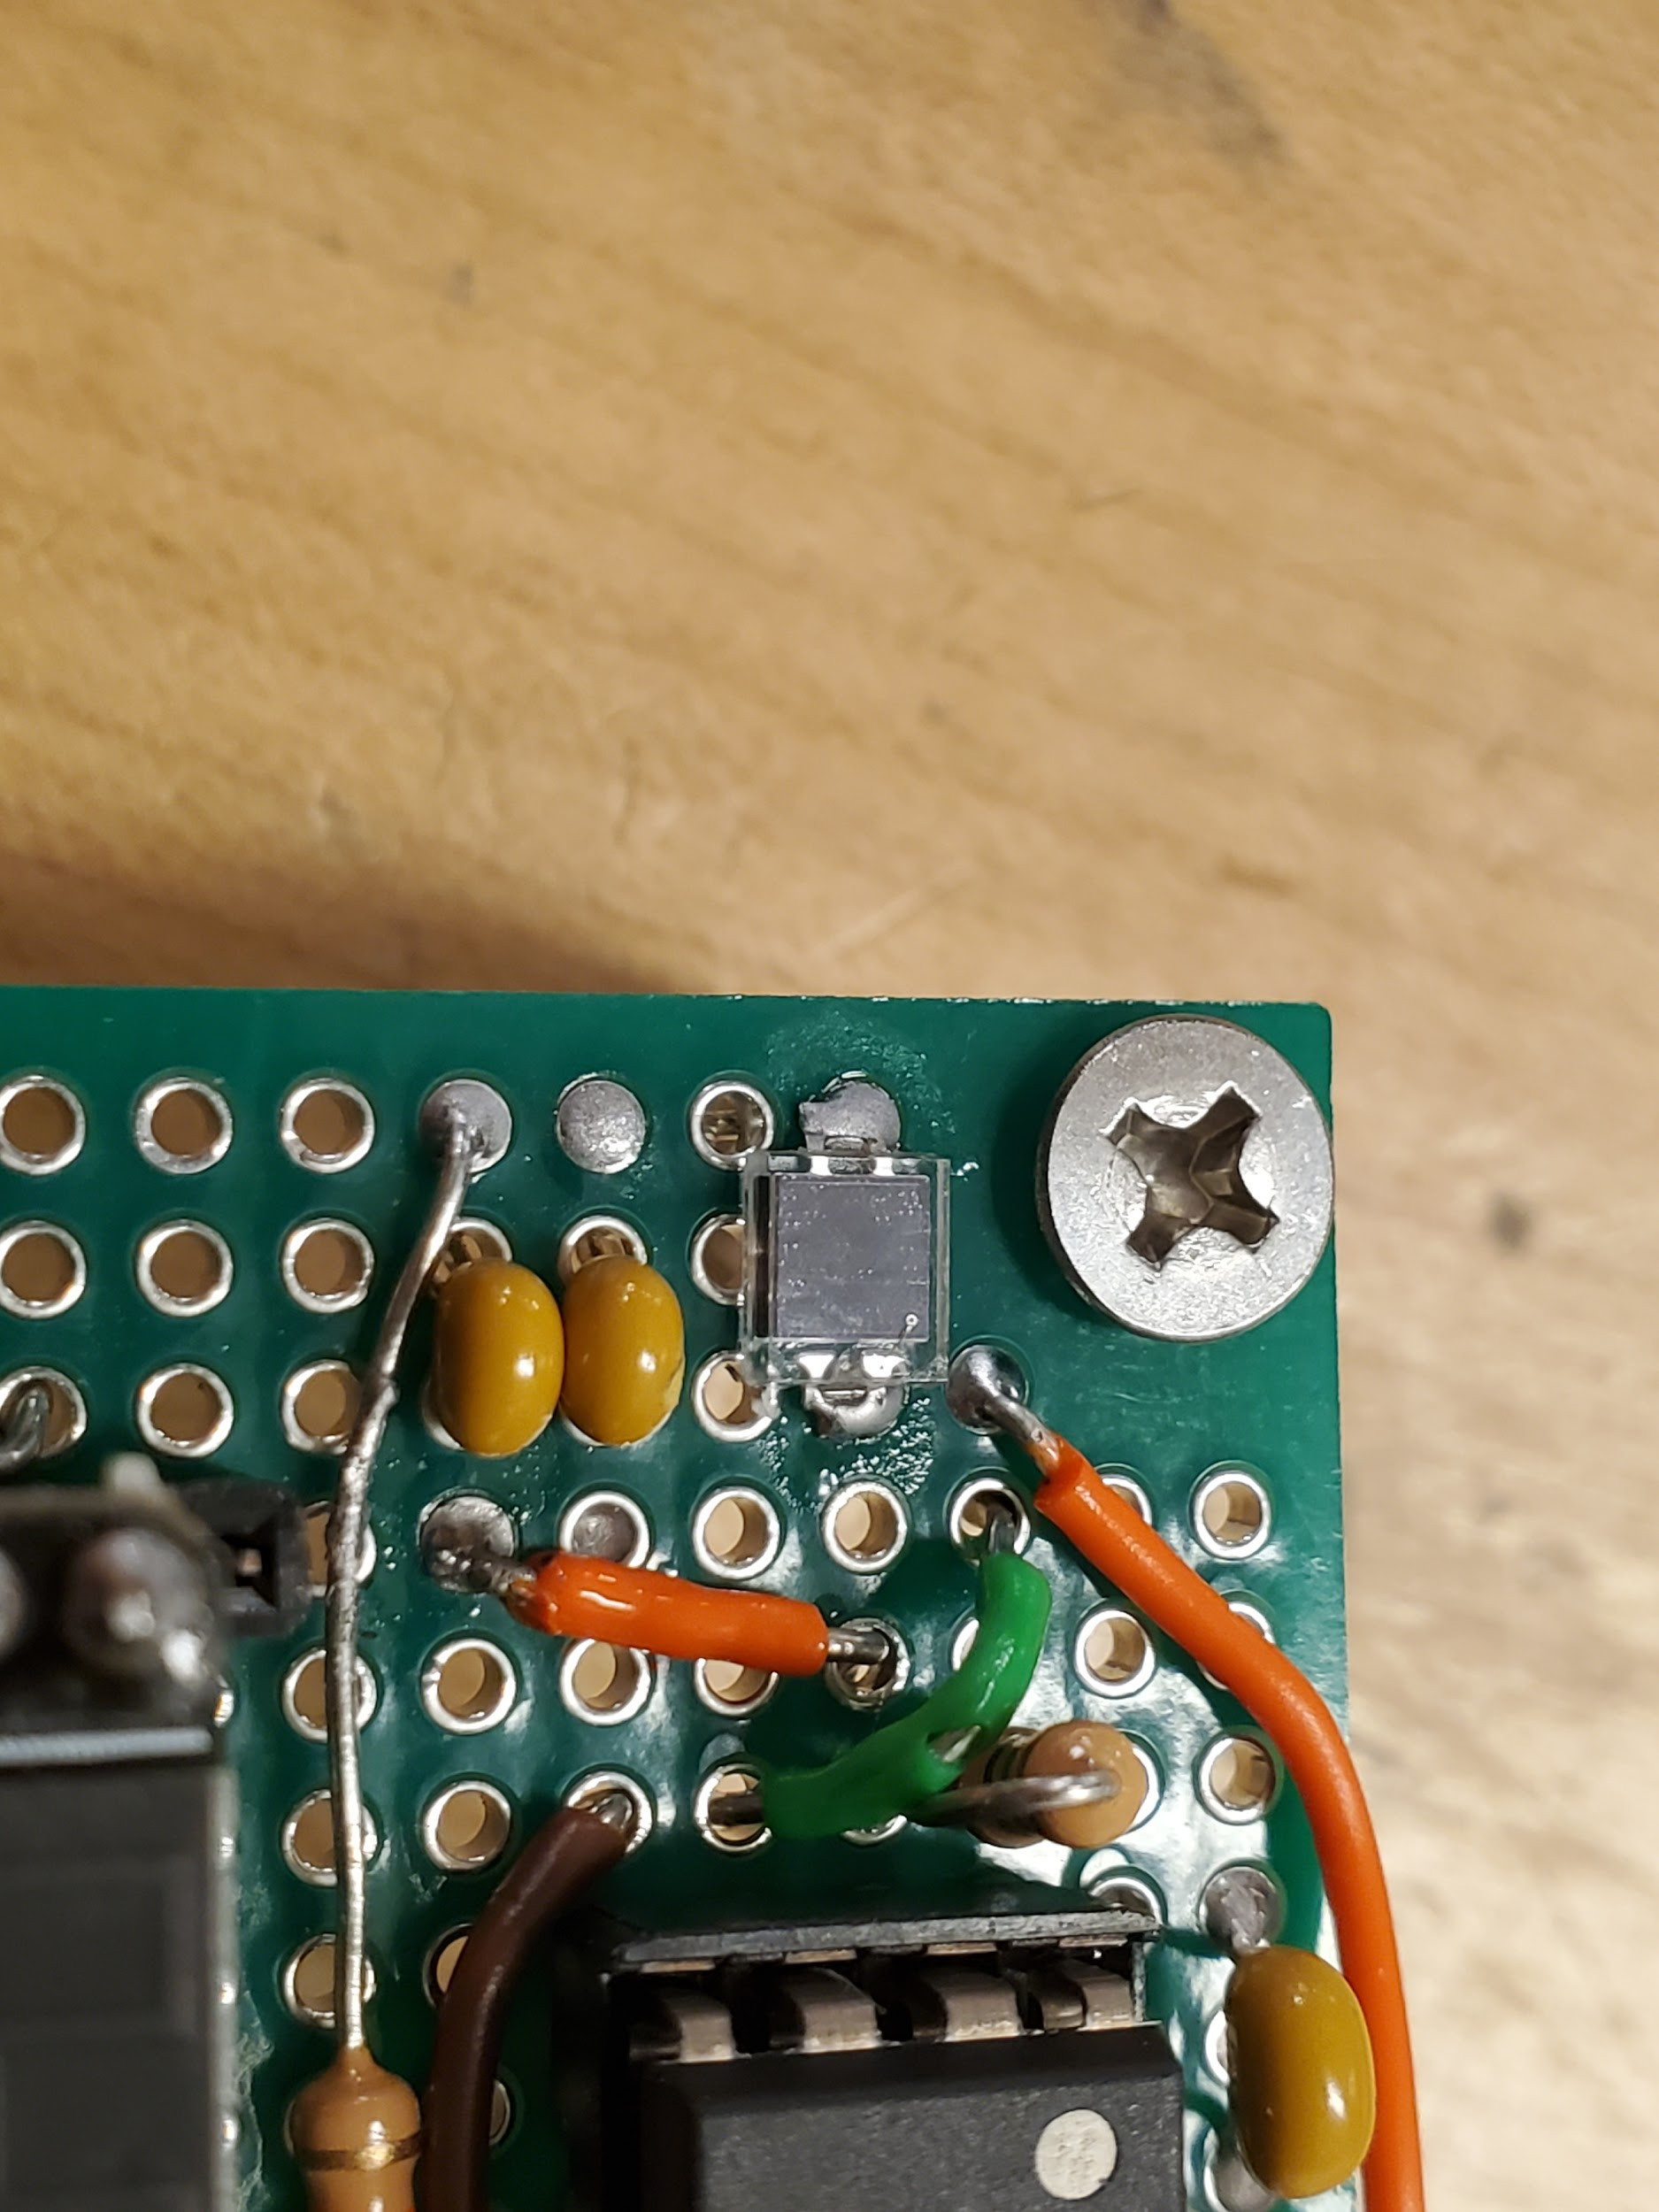
Soldering the PD70-01C Diode
Tape
Dot near Cathode
Lots of Solder
Note: remove tape residue.

Slide 14
The code - GIVEN!
Download files > Resources > ESP32 Arduino Lecture Examples > vive510
vive510.cpp
vive510.h
vive510.ipo

Slide 15
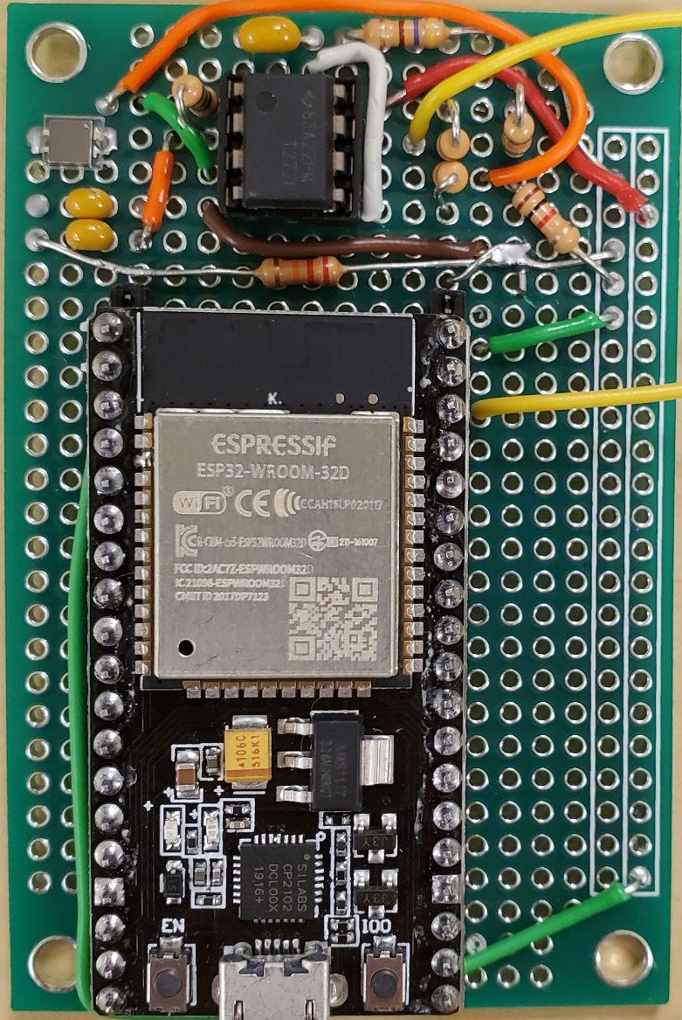
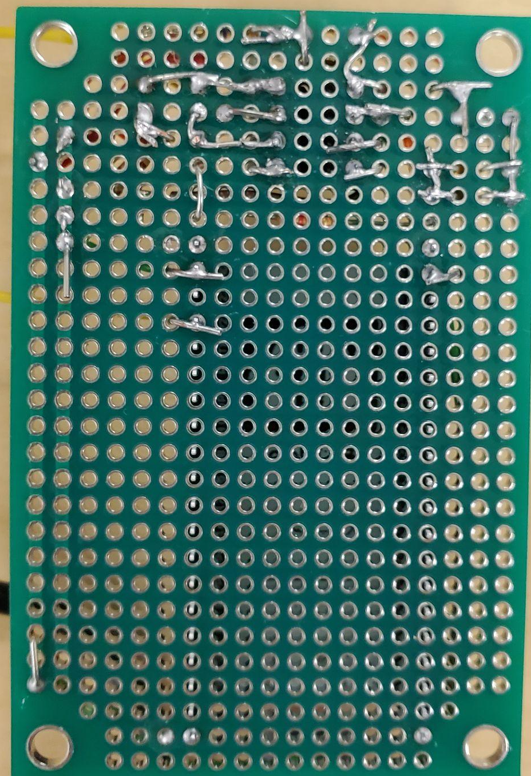
What this looks like

Slide 16
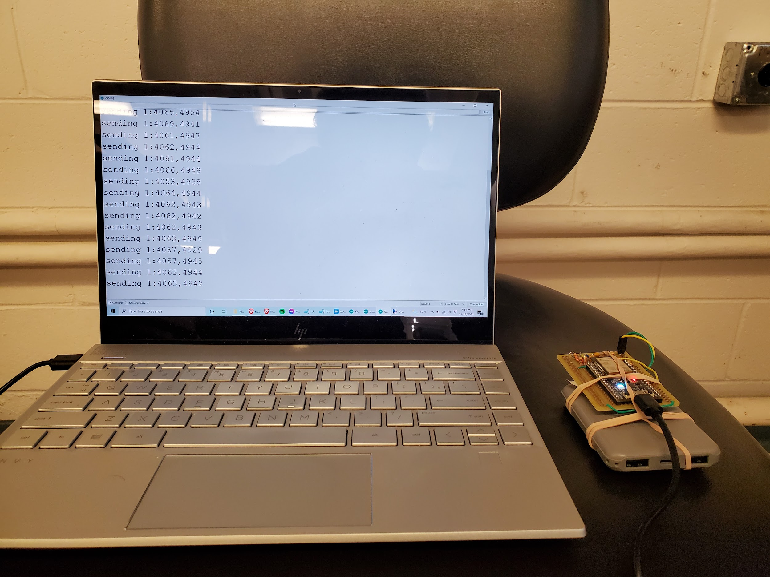
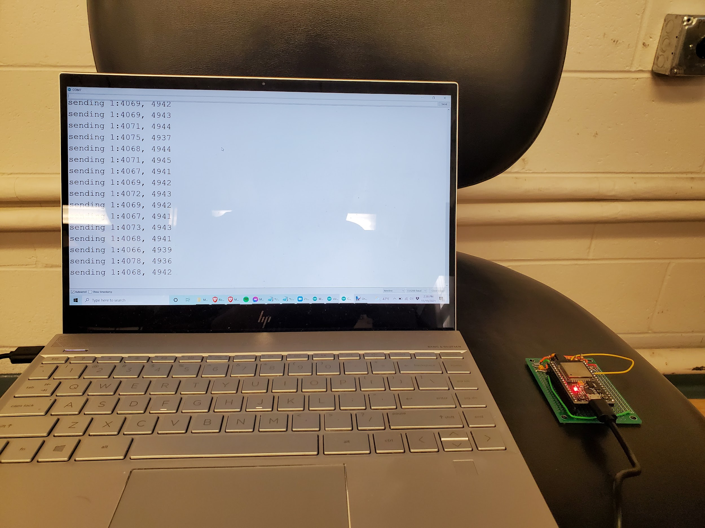
Comparing Between Detection Circuits (@ 3-4 ft)
(experiencing inconsistencies at board height)

Slide 17
Appendix

Slide 18
Control diagram / Terminology
Controller
input
Plant
(oven/car/robot)
state
Terms:
Regulator (set point)
Step Response
Controller
state
Control Law
input
Set Point (from user/external source)

Slide 19
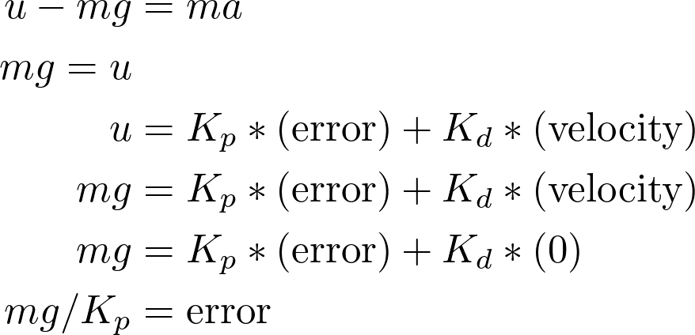
Proportional Integrative Derivative Control (PID)
How do we remove steady state errors (e.g. gravity)?
PD control law will result in a force balance with non-zero error
What is the steady state error with PD control?
z
mg
u

Slide 20
Feedback Controller uses PID and Rate Limiting
Compute error between setpoint distance from the wall and readings from ultrasonic
Compute desired bias based on proportional gain and magnitude of error
Compute rate limited desired bias
Create steering command by summing current period’s change in angle with current value
Threshold checker to evaluate if distance from right wall equals setpoint
Compute error between setpoint distance from the wall and readings from the ultrasonic sensor
Compute desired rightward bias based on proportional gain and magnitude of error
Compute rate limited desired rightward turn to avoid instabilities
Parameters to Add for PID Distance Regulation
PID gains (kp, ki, kd)
Rate limiter config (maximum change in directional bias allowed per timestep)
Desired wall following distance setpoint
Threshold checker bound

